Slide 1


Michal.Drobot
3D @ UBISOFT MTL

Slide 2
Low Level Optimizations for GCN
Hacking The New Generation

Slide 3
Agenda
GCN Architecture
Instruction Set
Optimizing ALU
  New Ways
  Ideas
  Tips & Tricks
Use Cases
Notes:
GCN is quite complex architecture wise.
Much closer to General Purpose CPU than Graphical unit.
Properly optimizing for general case requires a lot of knowledge and experience in latency hiding and parallel programming.
Aim of this talk is to expose several new ALU capabilities of the GPU – and show how they can be used in new ways to allow faster execution.
Main idea is to spark new ways of solving known problems – that allow greater flexibility or efficiency.
Every single thing presented here can be implemented and tested under 30 min!

Slide 4
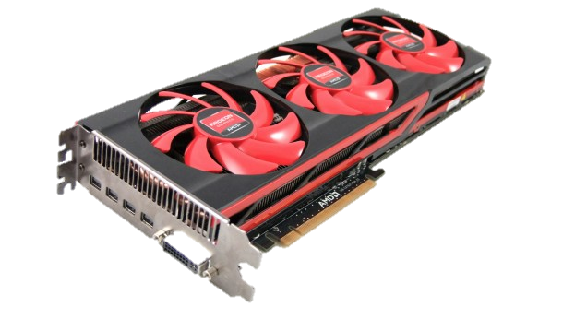
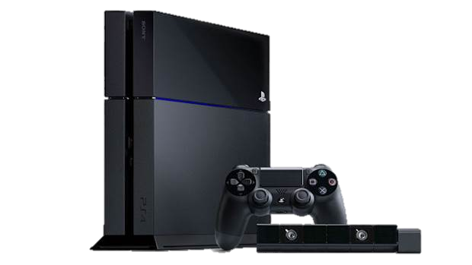

GCN Architecture
AMD Radeon HD 7xxx R7x R9x
Microsoft Xbox One
Sony Playstation 4
Notes:
Great times for optimizing Cross Platform games!
And each one has something special to keep it relevant for a long time.

Slide 5
GCN Architecture
Open documentation by AMD
  ISA
Well covered basics
  „Low-level Shader Optimization for Next-Gen and DX11” – Emil Persson
  „The AMD GCN Architecture: A Crash Course" - Layla Mah
Basics
  Keep it Wide : Occupancy : Low Resource (VGPR) usage
  Lots of ‚smart’ ALU – trade for bandwidth
  GCN super good at hiding latency – but needs help
Notes:
Today we focus on ALU

Slide 6
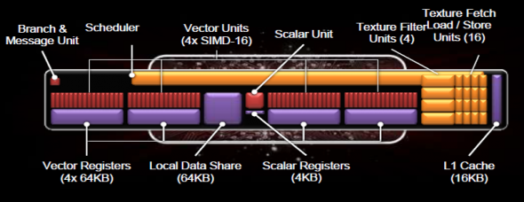
Optimizing ALU
GCN CU can execute 256 SP Vector ALU in 4 clk
Each lane dispatches 1 SP ALU op / clk
Each SP ALU takes 4 clk
SQ can dispatch from different wavefront each clk
Notes:
Effectively we can treat every atomic OP as 4 clk
OPs taking 4 clk are called to run at Full Rate

Slide 7
Basic OP Performance
32bit arithmetic and logical OPS
  Full Rate
  Exception int32 mul/mad @Quarter Rate
    Use int24 mul/mad if applicable @Full Rate
64bit arthimetic and logical OPS
  Half Rate
  Exception mul/mad @Quarter Rate
Conversion and Packing OPS
  All operands <=32bit @Full Rate
  Any operand >32bit @Half Rate

Slide 8
Special OP Performance
Transcendental Functions
  Use linear approximations
    Single function runs at all (4) SIMDs simultaniously
  @Quarter Rate
  Rcp, Sqrt, rsqrt, log, pow, exp, sin, cos
  Supporting OPs
    Cleanup, accuracy, denormal flushing @Full Rate
32 bit graphics special OP
  @Full Rate
  CubeMap OPs, Packed Byte OPs

Slide 9
Macro OP Performance
Macro unrolled OP
  tan, div, atan, acos, asin
  Smoothstep
  Length
  normalize
Unroll into IEEE compliant approximations
  Very expensive
Integer DIV
  Emulated with FP math
  Multiple Full and Quarter Rate OPs
Notes:
All macro ops are safe macros.
In most cases can be rewritten manually for performance.
Also all inverse trigonometric functions can be rewritten with polynomial approxiamtions to be less accurate but massively faster.

Slide 10
Code Flow Performance : BRANCH
BRANCH
  >= 4 WAIT states ~ >= 16 cycles ~ >= 16 Full Rate
    Branch support and logic
  Additional latency due to potential I$ miss
  Additioanl VGPR usage for IC / Label
  Can skip all OPS
    Much faster than BRANCH or SELECT
  Use always in case of redundant Buffer/Texture Memory OP
    Branch Latency <= L1$ latency
Notes:
Branch performance is much better than previous generation
Still expensive.
Just using the branch processor logic will cause a stall of at least 16 cycles = 16 FR ops.
Additional overhead may come in from Instruction Cache misses (imagine very long asm shader with JMP pointing far away).
Branch is the only code flow operator that is able to skip memory operations such as Tfetch.
L1 cache latency >= Branch Latency
In case of single EXP / LDS operation, branch will not be a win.

Slide 11
Code Flow Performance : VSKIP
VSKIP
  Special control flow mode
    Skips Vector OPs at rate of 10 wavefronts / clk
    CAN NOT VSKIP VMEM Ops
  For small pieces of Vector only code
    Much faster than BRANCH or SELECT
  Compilers are still catching up
    Write direct ASM if allowed
Notes:
If no memory operations are to be skipped – shorter ALU code potions benefit from VSKIP
VSKIP forces the SQ to skip certain number of wavefronts.
Runs in parallel.
Useful in ALU cases – think tile based lighting with multiple light shapes.
Keep in mind that ‚very long’ (depending on your occupancy) ALU code might be branched faster than skipped.
At the moment no compilr suports it directly, unless manual ASM is supported

Slide 12
Code Flow Performance : SELECT
SELECT
  Standard selector
  Execute two code paths
    SELECT one result based on Comparison
  [flatten]
  Ternary Logical Operator
  CndMask()
// SELECT use case
[flatten]
if(x > y)
z = x;
else
z = y;
/////////////
z = x > y ? x : y; // v_cndmask_b32 @ Full Rate
Notes:
In case of very short execution paths standard SELECTor will be a win.
Implemented as atomic ternary operator it will execute both paths and select the one matching the CND (condition) mask.
Normally hinted by [flatten]
Some compilers tend to use [branch] even if [flatten] is specified.
In that case resort to v_cndmask_b32 directly – i.e. CndMask() if implemented

Slide 13
VOP3 – 3 Operand Vector Instructions
IEEE flags free instructions banks for modifiers
  Input Modifiers :
    abs() neg()
  Output Modifiers:
    mul2 mul4 mul8 div2 div4
    saturate()
// Using VOP3
Out.x = saturate(abs(inV.x) * (-inV.y) * 4.0);
// In one OP
v_mul_f32 v0, abs(s), -v0 mul:4 clamp

Slide 14
VOP3 – 3 Operand Vector Instructions
Most compilers will automatically use VOP3 when
  Allowed (-fastmath –IEEEStrcit disabled)
  (-x)
  Saturate()
  *2.0 *4.0 *8.0 *0.5 *0.25

Slide 15
VOP3 – Restrictions
VOP3(VDST, VSRC0, VSRC1, VSRC2)
  VSRC0 – literals , VGPR, SGPR
  VSRC1 / VSRC2 – some restrictions on certain combinations
i.e. Can not issue both VSRC1 and VSRC2 from SGRPRs
Forces suboptimal
  SGRP to VGRP preload
  Disables VOP3
Notes:
GCN is a bit more restrictive on ternary operations (this was covered by Emil Persson in his talk)
Due to those restrictions, sometimes writing MAD code might actually be suboptimial.

Slide 16
VOP3 – Restrictions - Example
float2 TexcoordToScreenPos(float2 inUV, float4 inFov)
{
float2 p = inUV;
p.x = p.x * inFov.x + inFov.z;
p.y = p.y * inFov.y + inFov.w;
return p;
}
s_buffer_load_dwordx4 s[0:3], s[12:15], 0x08
s_waitcnt lgkmcnt(0)
v_mov_b32 v2, s2
v_mov_b32 v3, s3
s_waitcnt vmcnt(0) & lgkmcnt(15)
v_mac_f32 v2, s0, v0
v_mac_f32 v3, s1, v1
Notes:
This is a typical case that mose engines have inside of Screen Space based algorithms. Unfortunately it proves to be very subotpimal.

Slide 17
VOP3 – Restrictions – Example - Patch
float2 TexcoordToScreenPos(float2 inUV)
{
float2 p = inUV;
p.x = p.x * 2.0 + (- 1.0);
p.y = p.y * -2.0 + 1.0;
return p;
}
v_mad_f32 v0, v0, 2.0, -1.0
v_mad_f32 v1, v1, -2.0, 1.0
Notes:
A proper way to fix it is to patch the constants directly.
Depending on compiler it might be a huge win in case of tight loops – think Ray marching (Screen Space Reflecrions) code.

Slide 18
VOP3 – Constant Patching
Built In Fast Literal Constants
  Built in +/- 1 , 2 ,4, 8 constants - can use with all VOP3
Single Literal Constant support
  v_madak_f32
  v_madmk_f32
Notes:
Constant patching on GCN is HW supported. There are custom operations to lift previously mentioned restrictions when using literals.
In certain cases, where Literals end up in Vector operations, contant patching might significantly imrpve performance.

Slide 19
VOP3 – Constant Patching
Consider Uniform Patching
  If uniforms are constant
    Artist Generated shaders
    Particle Systems
    Transforms
Beneficial
  Higher chance of better scheduling
  Efficient tight loops (i.e. Screen Space Raymarching)
Balance unique shaders vs performance
  Crucial shaders can always be patched ‚on flight’ – PS3 style
Notes:
If you engine support art driven shader creation (node based), then you end up with multiple shader iterations having multiple different constants.
A reasonable solution is to minimize amount of different shaders , to minimize state switches and IC$ misses.
However, under certain conditions (shader reuse, heavy ALU shaders) it makes sense to use shader constant patching.
This proved to be valuable in Infamous : Second Son particle effect system.
In any case, for a small amount of different shader constant permutations, it might be beneficial to patch constants (especially if every shader can be used consecutively in multiple draw calls- to ammortize IC$ stalls).

Slide 20
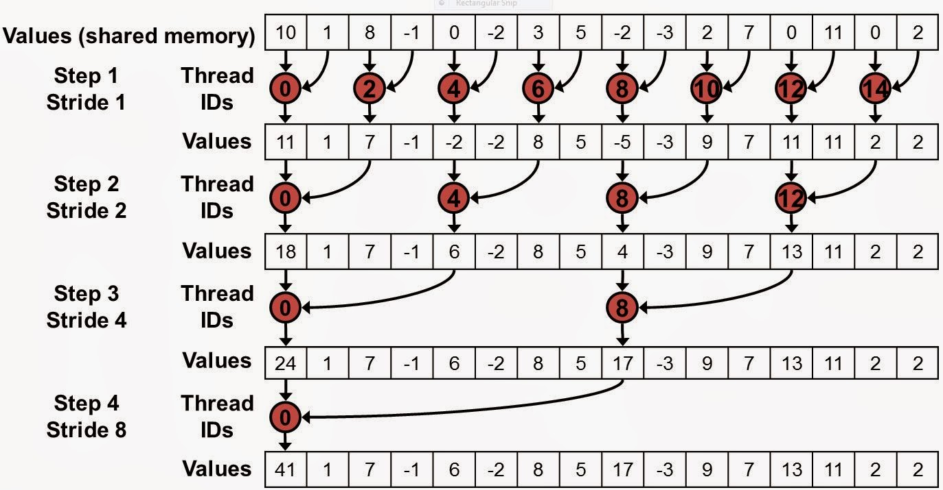
Special ALU OPs : Reduction
Min3
Max3
Med3
  Median
  Clamp()
Optimized
  Filtering
  Sorting
Notes:
Ternary Min/ Max / Med OPs are very helpfull in:
- reduction processing
- Sorting
Check Out:
Compute Shader Optimizations for AMD GPUs: Parallel Reduction – Wolfgang Engel

Slide 21
Special ALU OPs : Packing
GCN exposes multiple packing and conversion operations (used for compressed MRT)
  F32 -> F16
  F16 -> F32
  F32 -> SNorm / UNorm
  ...
  Also pairwise : 2xF32 -> 2xF16
  v_cvt_* - ISA OPs
Unpacking functions needs to be written manually
Notes:
GCN exposes multiple built in compression OPs normally used for EXP operations on compressed MRTs. Unfortunately decompression operations are unavailable and have to be implemented manually (which still can be very efficient with specialized OP set).

Slide 22
Special ALU OPs : BFE
GCN has full 32bit UINT / INT support
  Special OPs for masking, shifts, integer artihmetics
v_bfe_i32
  BitFieldExtract with sign extension to handle integer based packing
    Avoids manual care for sign extension due to 2-compliment Integer format
v_bfe_u32
  BitFieldExtract to handle unsigned integer based packing
    Bitmasks, flags, shift + mask
// reference implementation for v_bfe_u32
uint BitFieldExtract(uint inSrc, uint inOffset, uint inSize)
{
return (inSrc >> inOffset) & ((1 << inSize) – 1)
}
Notes:
Full U/INT support allows multilpe Integer Math based tricks known from x86 / x64 CPUs

Slide 23
Special ALU OPs : BFE
// reference implementation for v_bfe_i32
int BitFieldExtractSignExtend(int inSrc, uint inOffset, uint inSize)
{
uint size = inSize & 0x1f;
uint offset = inOffset & 0x1f;
uint data = inSrc >> offset;
uint signBit = data & (1 << (size - 1));
uint mask = (1<<size) - 1;
return (-int(signBit)) | (mask & data);
}
// Pack 127, -1, -126 into RGB 11 11 10
// Integers are 2’s complement
// packed_data = 00001111111 11111111111 1110000010
// Unpack R(127)
BFE(packed_data, 21, 11) = 0000 0000 0000 0000 0000 0000 0111 1111
// Unpack B(-126)
BFE(packed_data, 0, 11) = 1111 1111 1111 1111 1111 1111 1000 0010
Notes:
Bit Field Extract is the most flexible Int based opetion (apart from Math based operators).
Allows you to stop worrying and love the 2’s complement Int

Slide 24
Special ALU OPs : BFE Pack - Unpack
Fast Int Packing and Unpacking
// Int16 packing
int PackInt2ToInt(in int inX, in int inY)
{
return (clamp(inX, -int(0x8000), 0x7fff) & 0xffff) |
(clamp(inY, -int(0x8000), 0x7f00) << 16);
}
int2 UnpackInt2FromInt(in int inPackedInt)
{
return int2(
BitFieldExtractSignExtend((int)inPackedInt, uint(0), uint(16)), BitFieldExtractSignExtend((int)inPackedInt, uint(16), uint(16)));
}
Notes:
Very helpful in fast signed number packing

Slide 25
Special ALU OPs : BFE Pack - Unpack
Fast SNorm16 Packing - Unpacking
// SNorm16 packing
uint PackSNorm2ToUInt(in float inX, in float inY)
{
return (clamp(int(inX * 0x7fff), -int(0x7fff), 0x7fff) & 0xffff) | clamp(int(inY * 0x7fff), -int(0x7fff), 0x7fff) << 16);
}
float2 UnpackSNorm2FromUInt(in uint inPackedUInt)
{
return float2(
BitFieldExtractSignExtend((int)inPackedUInt, uint(0) , uint(16))/float(0x7fff), BitFieldExtractSignExtend((int)inPackedUInt, uint(16), uint(16))/float(0x7fff));
}
Notes:
Very helpful in fast signed number packing

Slide 26
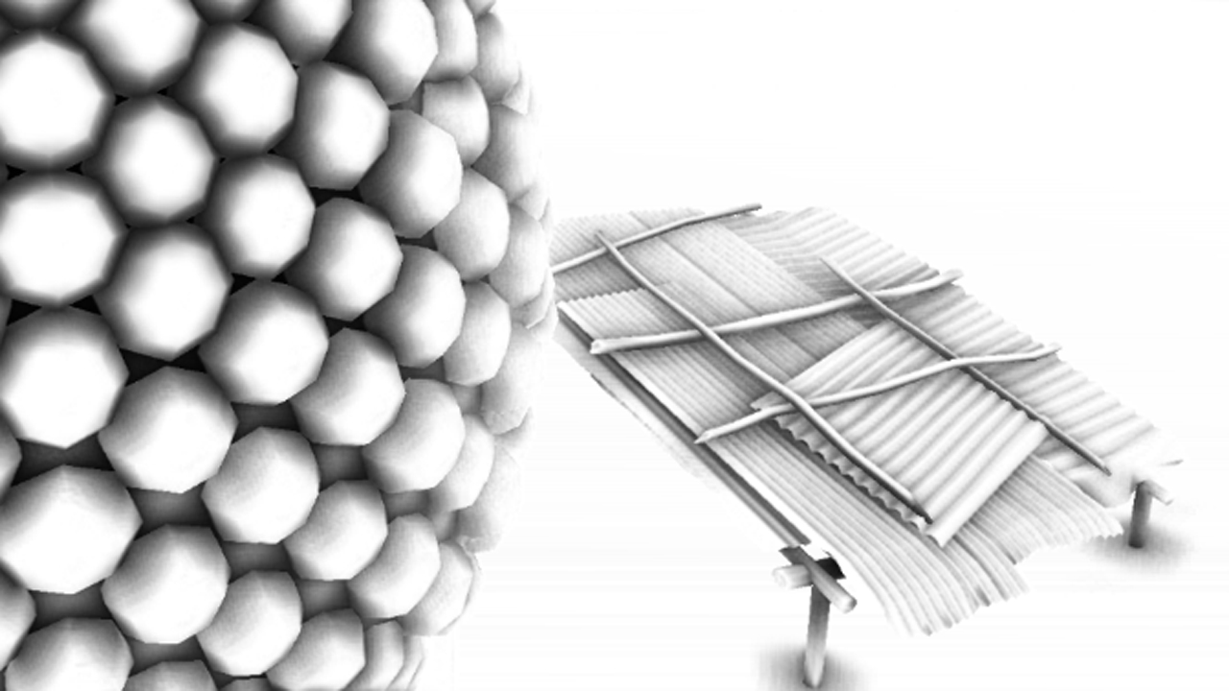
Special ALU OPs : Sampling Packed Data
Pack data into ‚fat’ format
Sample with GATHER
Example : Bilateral Filter
Pack all into UINT32
  8 bit DATA
  16 bit Depth
  8 bit Normal
    as 4bit SNORM
1 Gather :
  4 x data
  4 x depth
  4 x normal
Notes:
This generation we have even more ALU to trade for Bandwidth.
Gather offers excellent sampling rate of packed formats.
Example:
Bilateral Filtering – up to 30% faster than using seperate texture for normals.

Slide 27
Special ALU OPs : Packing
Use Bitfields to reduce register pressure with lifetime bool flags
  Countbits()
  Firstbithigh()
  Firstbitlow()
uint FastLog2(uint inX)
{
return firstbithigh(inX) – 1;
}
Notes:
Full support for bit counting ops on GCN.
Allow Boolean operations optimizations. Multiple Boolean statements can be expressed as one bitmask minimizing VGRP usage.
Also enable ‘trick’ integer math (well known to SPU users – such as fast Log2).

Slide 28
Special ALU OPs : BFE – boolean ops
// Software Triangle Frustum (near plane) clipping
// Vertex Sorting before line equations
float v0 = b[0]; float v1 = b[1]; float v2 = b[2];
if(b[0] > near_z || b[1] > near_z || b[2] > near_z)
{
if(b[1] > near_z) { v0 = t[1]; v1 = t[2]; v2 = t[0]; }
if(b[2] > near_z) { v0 = t[2]; v1 = t[0]; v2 = t[1]; }
}
if(
(b[0] > near_z && b[1] > near_z) ||
(b[0] > near_z && b[2] > near_z) ||
(b[1] > near_z && b[2] > near_z)
)
{
if(!(b[0] > near_z)) { v0 = t[1]; v1 = t[2]; v2 = t[0]; }
if(!(b[1] > near_z)) { v0 = t[2]; v1 = t[0]; v2 = t[1]; }
}
// Compiles to : 42 ALU @ Full Rate + 4 BRANCH @ (>= 16 FR)
Notes:
Typical manual, software triangle clipper.
When a triangle is sliced by near Z plane, it can have multiple vertex configurations that need to get sorted before line intersections.
This code can be extremely heavy on VGPR / ALU

Slide 29
Special ALU OPs : BFE – boolean ops optimized
// Software Triangle Frustum (near plane) clipping
// Vertex Sorting before line equations
uint bitfield = 0;
bitfield |= b[0] > near_z ? 0x1 << 0 : 0x0;
bitfield |= b[1] > near_z ? 0x1 << 1 : 0x0;
bitfield |= b[2] > near_z ? 0x1 << 2 : 0x0;
float v0 = b[0]; float v1 = b[1]; float v2 = b[2];
uint csb = CountSetBits(bitfield);
uint csb_eq2 = (csb >> 1) & 0x1;
if(bitfield & 0x2 & csb) { v0 = t[1]; v1 = t[2]; v2 = t[0]; }
if(bitfield & 0x4 & csb) { v0 = t[2]; v1 = t[0]; v2 = t[1]; }
if(!(bitfield & 0x1) && csb_eq2) { v0 = t[1]; v1 = t[2]; v2 = t[0]; }
if(!(bitfield & 0x2) && csb_eq2) { v0 = t[2]; v1 = t[0]; v2 = t[1]; }
// Compiles to : 35 ALU @ Full Rate
Notes:
With bit masking it can be significantly optimized allowing almost 2x speedup in real life case – tested on Compute Shader software rasterizer.
Over 3x speed improvement in real scenario.

Slide 30
Special ALU Ops : Cubemap
Cubemaps are sampled using unified image_sample
Need to calculate face UV and face ID for sampling
  All HW accelerated by custom OPs @Full Rate
v_cubetc_f32 v1, v2, v3, v0 // calculate tc coords
v_cubesc_f32 v4, v2, v3, v0 // calculate tc coords
v_cubema_f32 v5, v2, v3, v0 // calculate major axis
v_cubeid_f32 v8, v2, v3, v0 // calculate face ID
v_rcp_f32 v2, abs(v5)
s_mov_b32 s0, 0x3fc00000
v_mad_f32 v7, v1, v2, s0 // calculate final face UV
v_mad_f32 v6, v4, v2, s0 // calculate final face UV
image_sample v[0:3], v[6:9], s[4:11], s[12:15] // Tex Array
Notes:
Cubemap sampling follow uniform texture fetch code path. All UV calculation is split , and handled by specialized OPs.
Several of those OPs can be adapted to different use cases.

Slide 31
Special ALU Ops : Major Axis
// reference implementation for v_cubeid_f32
float CubeMapFaceID(float inX, float inY, float inZ)
{
float3 v = float3(inX, inY, inZ);
float faceID;
if(abs(v.z) >= abs(v.x) && abs(v.z) >= abs(v.y))
{
faceID = (v.z < 0.0) ? 5.0 : 4.0;
}
else if (abs(v.y) >= abs(v.x))
{
faceID = (v.y < 0.0) ? 3.0 : 2.0;
}
else
{
faceID = (v.x < 0.0) ? 1.0 : 0.0;
}
return faceID;
}
Notes:
Cubemap supporting functions = problem of finding Major Axis.
This is one of very useful cube map Ops, solving one of typical algorithmic problems @ Full Rate speed.

Slide 32

Special ALU Ops : Major Axis
Use v_cubeid_f32 , v_cubema_f32 in Major Axis problems
  Normal Compression
  Quaternion Compression
  (Uniform) Custom Kernel Filtering at Cubemap borders
  Atlased Cubemaps
  Cubemap raymarching optimizations
  Several problems in Ray-Casting

Slide 33

Special ALU Ops : Normal Storage Precision
Normalized Vector
$1= \sqrt[2]{x^{2}+y^{2}+z^{2}}$
Store X, Y – reconstruct Z
$z= \sqrt[2]{1−\left(x^{2}+y^{2}\right)}=\sqrt[2]{1−d}, d=x^{2}+y^{2}$
Z precision depends on
  $E\left(z\right)=ⅆd ∗Er\left(x,y\right), where E\left(x\right) is error function of storage and reonstruction$
$\frac{d}{dd}\left(z\right)=\frac{d}{dd}\left(\sqrt{1−d}\right)=−\frac{1}{2\sqrt{1−d}}$
Precision error arises from:
$\lim_{d→1}{{−\frac{1}{2\sqrt{1−d}}}^{}}= ∞$
  $d=x^{2}+y^{2} →1⇒E\left(z\right)→∞$
Notes:
Standard way of normalized N dimensional vector storage is reconstruction from Normal Vector definition.
Unfortunately for uniform distribution of normal, the error function is unbound, what is easily proven.
Practically that means, that nearing certain angles, error renders the reconstruction useless.

Slide 34

Special ALU Ops : Normal Storage Precision
Typical way of minimizing error
  Limit the error function by bounds
To minimize E(z) we need to minimize function d
Simple solution
$d(x,y)=m^{2}+n^{2},$
  $where: m=\min\left(x,y,z\right), n=med\left(x,y,z\right)$, $1= \sqrt[2]{x^{2}+y^{2}+z^{2}}$
$d(x,y)$– becomes upper bounded by : $\frac{2}{3}$
$\lim_{d→\frac{2}{3}}{{−\frac{1}{2\sqrt{1−d}}}^{}}=−\frac{\sqrt{3}}{2}$
Notes:
By upper bounding d(x,y) function we managed to upper bound the reconstruction error to a reasonable sqrt(3)/2 * Fixed Storage * Foxed Reconstruction Error

Slide 35

Special ALU Ops : Normal Storage Precision
$E\left(n,n^{′}\right)=1−n⋅n′$
Standard Reconstruction
  7bit SNorm X, Y + 1bit sign
  $MSE\left(n,n^{′}\right) ≈\frac{3.04}{10000},over X,Y domain, where 1= \sqrt[2]{x^{2}+y^{2}+z^{2}}$
  $Useless n^{′}:E\left(n, n^{′}\right)>\frac{1}{1024}≈5.4\%$
Notes:
Assume that up to 1/1024 deviation of reconstructed normal is usable (many engines rely on 10 bit normals)
For standard compression we get reasonable MSE over whole domain, however more than 5% of directions will be useless.
We would be rather interested in uniform error distribution, keeping the worst case at bay.
Chart shows a single plane for x at y = 0.25

Slide 36

Special ALU Ops : Normal Storage Precision
$E\left(n,n^{′}\right)=1−n⋅n′$
Major Axis (minimum m,n from x,y,z)
  7bit SNorm M,N + 2.5bit sign/order index
  $MSE\left(n,n^{′}\right) ≈\frac{1.18}{10000},over X,Y domain, where 1= \sqrt[2]{x^{2}+y^{2}+z^{2}}$
  $Useless n^{′}:E\left(n, n^{′}\right)>\frac{1}{1024}≈0.022\%$
Notes:
With Major Axis packing we minimized deviation, thus rendering almost all possible directions useful.
Considering relatively small operation cost -> huge improvement.
Improved : Average Case ~3x , Usable Vectors (deviation) ~250

Slide 37
Special ALU Ops : Major Axis
float3 PackNormalMajorAxis(float3 inNormal)
{
uint index = 2;
if(abs(inNormal.x) >= abs(inNormal.y) && abs(inNormal.x) >= abs(inNormal.z))
index = 0;
else if(abs(inNormal.y) > abs(inNormal.z)
index = 1;
float3 normal = inNormal;
normal = index == 0 ? normal.yzx : normal;
normal = index == 1 ? normal.xzy : normal;
float s = normal.z > 0.0 ? 1.0 : -1.0;
float3 packedNormal;
packedNormal.xy = normal.xy * s;
packedNormal.z = index / 2.0f;
return packedNormal;
}
// Compiles to :
// 28 ALU @ Full Rate + 2 BRANCH @ (>= 16FR)
Notes:
Compression Code – relatively expensive. In real execution would stall for at least 60 Full Rate OPs

Slide 38
Special ALU Ops : Major Axis
float3 PackNormalMajorAxis(float3 inNormal)
{
uint index = CubeMapFaceID(inNormal.x, inNormal.y, inNormal.z) * 0.5f;
float3 normal = inNormal;
normal = index == 0 ? normal.yzx : normal;
normal = index == 1 ? normal.xzy : normal;
float s = normal.z > 0.0 ? 1.0 : -1.0;
float3 packedNormal;
packedNormal.xy = normal.xy * s;
packedNormal.z = index / 2.0f;
return packedNormal;
}
// Compiles to :
// 17 ALU @Full Rate
Notes:
Using GCN specialized instructions stall is reduced to 17 @ Full Rate = 70% optimization
Remember that this method can be used with other non bounded functions. Get creative.

Slide 39
Interpolator : Interpolation
Triangle Data
VS->PS interpolation on GCN is ‚manual’
  Unrolled by compiler
  Optimized in HW
LDS contains vertex data per rasterized traingle
PS fetches the data and interpolates manually
PS
Quad
LDS
Notes:
Interpolation on GCN is a big departure form fixed pipeline used in previous generation HW.
For the first time PS has direct access to Vertex Data – technically bypassing any fixed HW on the way (apart from quad scheduling / preparation unit).

Slide 40
Interpolator : Interpolation
P1
P0, P1, P2
  Hold Vertex Data
Vi Vj
  Barycentric Coordinates
Depending on Interpolant settings
  Interplolate
    At center, sample, centroid
  No interpolation (nointerpolation)
    Also forced on INT type
    Fetches data from V0 – Vertex 0
Vi
Vj
P0
PS
Quad
Vi
Vj
P2
float4 Interpolate( float4 A, float4 B, float4 C, float2 Vij )
{
return A * (1.0 – Vij.x – Vij.y) + B * Vij.x + C * Vij.y;
}
Notes:
Multiple new algorithms including custom interpolation are possible now.

Slide 41
Interpolator : Mode
struct Interpolants
{
float4 position : SV_POSITION;
float4 color : COLOR0;
};
float4 main( Interpolants In ) : COLOR{
float4 Out;
Out = In.color;
return Out;
}
v_interp_p1_f32 v2, v0, attr0.x // Load Data for Attr0 from LDS and perform
// Vi - first part of
// interpolation (using V00, V01)
v_interp_p2_f32 v2, v1, attr0.x // Load Data for Attr0 from LDS and perform // Vj - second part of
// interpolation (using V01, V10)
v_interp_p1_f32 v3, v0, attr0.y
v_interp_p2_f32 v3, v1, attr0.y
v_interp_p1_f32 v4, v0, attr0.z
v_interp_p2_f32 v4, v1, attr0.z
v_interp_p1_f32 v0, v0, attr0.w
v_interp_p2_f32 v0, v1, attr0.w
Notes:
Interpolation is accelerated by 2 complimentary operations.
v_interp_p1 interpolates using Vi between P0 and P1 data.
v_interp_p2 interpolates using Vj between v_interp_p1 result and P2 data.

Slide 42
Interpolator : Mode
struct Interpolants
{
float4 position : SV_POSITION;
int4 color : COLOR0;
};
int4 main( Interpolants In ) : COLOR{
int4 Out;
Out = n.color;
return Out;
}
v_interp_mov_f32 v0, p0, attr0.x // Load Data from Vertex p0 for Attr0 from LDS
v_interp_mov_f32 v1, p0, attr0.y // Load Data from Vertex p0 for Attr0 from LDS
v_interp_mov_f32 v2, p0, attr0.z // Load Data from Vertex p0 for Attr0 from LDS
v_interp_mov_f32 v3, p0, attr0.w // Load Data from Vertex p0 for Attr0 from LDS
Notes:
Using int or uint format (format that can not be subject to interpolation) results in –nointerpolation flag by default

Slide 43
Special ALU Ops : Interplator Compression
GCN allows to poll for HW rasterizer Vi Vj – barycentric coordinates
  Calculated according to set interpolator flags
Opens possibility for custom interpolation and packing
Geometry Shader and Tessellation Pipeline – Data amplfication
  Requires huge BW
  Use interpolator packing to optimize BW
PS can also be bottlenecked by LDS
  Too much LDS used for ‚fat’ Vertex Data
Never interpolate triangle const data!
Notes:
In most cases memory is more expxensive than ALU.
This is especially true during data amplification and OFF-Chip data transfes.
A common scenario is Data Write Out to OffChip memory through Geometry Shader and / or Tessellation pipeline.
Than data is read back for Pixel Shading stages.
In that case any saving on data transfer will massively help.
At least do not interpolate what you don’t need to!
Typical legacy case :
Byte Colour per Particle – pack RGBA into 1 UINT – no interpolation
Manual Instance ID passed as float - pack into UINT – no interpolation

Slide 44
Interpolator : Packing
Read Vertex Data
  v_interp_mov_f32 v0, p0, attr0.x // Vertex P00
  v_interp_mov_f32 v0, p10, attr0.x // Vertex P10
  v_interp_mov_f32 v0, p20, attr0.x // Vertex P20
Barycentric Coordinates Vi Vj
  Preloaded in VGPRs (compiler does it for you)
Notes:
All data required for interpolation can be read explicitly – allowing direct access to triangle data.

Slide 45
Interpolator : Packing
float4 Interpolate( float4 A, float4 B, float4 C, float3 barycentric )
{
return A * barycentric.z + B * barycentric.x + C * barycentric.y;
}
float3 barycentric;
barycentric.xy = GetBarycentricCoordsPerspectiveCenter(); // Read Vi Vj from HW
barycentric.z = 1 - barycentric.x - barycentric.y;
uint rawA = ( GetVertexParameterP0( In.color_packed ) ); //Read Raw UINT Data from V00
uint rawB = ( GetVertexParameterP1( In.color_packed ) ); //Read Raw UINT Data from V01
uint rawC = ( GetVertexParameterP2( In.color_packed ) ); //Read Raw UINT Data from V10
float4 decompressedA = UnpackColor( rawA ); //Unpack Byte from UINT and convert to float
float4 decompressedB = UnpackColor( rawB ); //Unpack Byte from UINT and convert to float
float4 decompressedC = UnpackColor( rawC ); //Unpack Byte from UINT and convert to float
float4 Out;
Out = Interpolate( decompressedA, decompressedB, decompressedC, barycentric );
Notes:
Direct access to triangle data allows manual interpolation and packing.

Slide 46
PS LDS access : Triangle Data
PS can read Vertex Data directly from rasterized triangle
Multiple algorithms previously reserved for GS posible in PS
  Parallax Curvature estimation
  (Closest) Distance to Edge
  (Closest) Distance to Vertex
  Spline Interpolated Normals / Curvature
Notes:
All OPs for manual interpolation allow direct triangle data access. This open possibility for all algorithms that were previously bound to Geometry Shader stages (due to knowledge of full triangle requirement). Now it is possible to execute those programs on PS level, minimizing prohibitive Off-Chip / On-Chip traffic that hindered previous solutions.
The are multiple applications of this technique:
Closest Distance To Edge

Slide 47
PS LDS access : Triangle Data
PS can read Vertex Data directly from rasterized triangle
Multiple algorithms previously reserved for GS posible in PS
  Parallax Curvature estimation
  (Closest) Distance to Edge
  (Closest) Distance to Vertex
  Spline Interpolated Normals / Curvature
Notes:
Closest distance To Vertex

Slide 48
PS LDS access : Triangle Data
PS can read Vertex Data directly from rasterized triangle
Multiple algorithms previously reserved for GS posible in PS
  Parallax Curvature estimation
  (Closest) Distance to Edge
  (Closest) Distance to Vertex
  Spline Interpolated Normals / Curvature
Notes:
Second Order interpolation of normal.
Spline based normal interpolation as approximate curvature estimation.
i.e. silhouette parallax mapping.

Slide 49
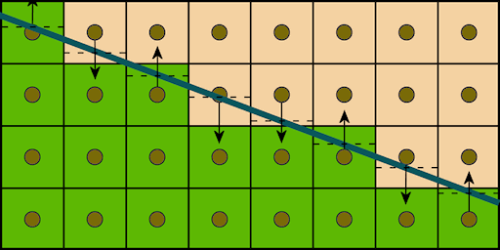
PS LDS access : Distance to Edge
Example : Distance To Edge AA
  Output distance to closest edge
  Directly from PS bypassing GS
  Used in multiple analytical AA methods
    GBAA
    DEAA
d1
d2
d0
Notes:
Analytical Anti Aliasing methods rely on output analytical distances to triangle / silhouette edge.
One possible solution is to calculate distances to edge for rendered pixel and write it our in auxiliary buffer. Later use the buffer to offset color samples for technically infinite AA effect.

Slide 50
PS LDS access : Distance to Edge
Example : Distance To Edge AA
  Output distance to closest edge
  Directly from PS bypassing GS
  Used in multiple analytical AA methods
    GBAA
    DEAA
D = min3(d0, d1, d2)
d1
d2
d0
Notes:
Once all distances are calculated, the closest one is picked, compressed on per axis basis and written into a buffer.
More expensive algorithms can output all distances for follow up neighborhood sampling that would try to avoid subpixel artifacts, that are common with most analytical methods (see GBAA, DEAA papers).

Slide 51
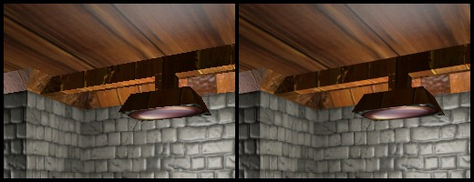
PS LDS access : Distance to Edge
  Previously impractical due to expensive GS on every mesh
  Now totally viable option
    Excellent performance
  Check HUMUS GBAA
    Just move Geometry Shader part to Pixel Shader
Notes:
Performance of analytical solutions, with proposed implementation is surprisingly high.
Most ALU and triangle data access operations are easily hidden in modern g-buffer material execution shaders.
In two titles, that this method was implemented, we seen performance degradation only due to additional BW.
Obviously your results may vary depending on your shaders bottlenecks.
You still need to asses if you can live with possible subpixel artifacts.
In case of highly stylized game with huge triangles – you should be more than satisfied.

Slide 52
Transcendental Functions
rcp(x), sqrt(x), rsqrt(x)
  Most common transcendental functions in rendering
  @Quarter Rate – 16 cycles each
  Common in loops
    Light iterators
    SSAO
    Multisampling
    Raymarching
  Used by macro
    Length(x)
    Normalize(x)

Slide 53

Transcendental Functions : Example
// SLOW code – some compilers are not aggressive enough to optimize macros
float3 vector;
float vectorLength = length(vector); // compiler best case :
//expands to sqrt(dot(vector, vector))
float3 normalVector = normalize(vector); // compiler best case : expands to
// vector * rsqrt(dot(vector, vector))
// Timings : (FR - Full Rate cycle - 4 cycles):
v_mov_b32 v0, s2 // 1FR
v_mul_f32 v1, s2, v0 // 1FR
v_mov_b32 v2, s1 // 1FR
v_mac_f32 v1, s1, v2 // 1FR
v_mov_b32 v3, s0 // 1FR
v_mac_f32 v1, s0, v3 // 1FR
v_sqrt_f32 v1, v1 // 4FR
v_mul_f32 v0, s2, v0 // 1FR
v_mac_f32 v0, s1, v2 // 1FR
v_mac_f32 v0, s0, v3 // 1FR
v_rsq_f32 v0, v0 // 4FR
v_mov_b32 v2, #0x7f7fffff // 1FR
v_mov_b32 s3, #0xff7fffff // 1FR
v_med3_f32 v0, v0, s3, v2 // 1FR
v_mul_f32 v2, s0, v0 // 1FR
v_mul_f32 v3, s1, v0 // 1FR
v_mul_f32 v0, s2, v0 // 1FR
// Total not counting MOV //18 FR

Slide 54
Transcendental Functions : Example
// help compiler by manually unrolling macros
// this is always a good practice
float dotVector = dot(inVector,inVector);
float vectorLength = sqrt(dotVector);
float3 normalVector = inVector * rcp(vectorLength);
// Timings : (FR - Full Rate cycle - 4 cycles):
v_mov_b32 v0, s2 // 1 FR
v_mul_f32 v0, s2, v0 // 1 FR
v_mov_b32 v1, s1 // 1 FR
v_mac_f32 v0, s1, v1 // 1 FR
v_mov_b32 v1, s0 // 1 FR
v_mac_f32 v0, s0, v1 // 1 FR
v_rsq_f32 v1, v0 // 4 FR
v_sqrt_f32 v0, v0 // 4 FR
v_mul_f32 v2, s0, v1 // 1 FR
v_mul_f32 v3, s1, v1 // 1 FR
v_mul_f32 v1, s2, v1 // 1 FR
// Total not counting MOV //14 FR

Slide 55

Transcendental Functions : Example
// We can do much better for FR count and pipelining by exploiting:
// sqrt(x) = rsqrt(x) * x
// rcp(x) = rsqrt(x) * rsqrt(x) // only for positive X
float dotVector = dot(inVector,inVector);
float rcpVectorLength = rsqrt(dotVector);
float vectorLength = rcpVectorlength * dotVector;
float3 normalVector = inVector * rcpVectorLength;
// Which results in:
v_mov_b32 v0, s2 // 1 FR
v_mul_f32 v0, s2, v0 // 1 FR
v_mov_b32 v1, s1 // 1 FR
v_mac_f32 v0, s1, v1 // 1 FR
v_mov_b32 v1, s0 // 1 FR
v_mac_f32 v0, s0, v1 // 1 FR
v_rsq_f32 v1, v0 // 4 FR
v_mul_f32 v0, v0, v1 // 1 FR
v_mul_f32 v2, s0, v1 // 1 FR
v_mul_f32 v3, s1, v1 // 1 FR
v_mul_f32 v1, s2, v1 // 1 FR
// Total not counting MOV //11 FR

Slide 56

Approximated Transcendental Functions
Transcendental Functions in HW provide ~1 ULP of precision
We do not always need that much
  Especially for F16, F11, UNorm8 data
Can we do a better job than HW @ Quarter Rate?

Slide 57
Special ALU Ops : Integer Math
General Purpose Registers
  Integer Math
  No reinterpretation cost
Integer support
  Allows integer based floating point math
// asint() / asfloat() works as reinterpret_cast
// is free – just hints the compiler to treat the data using different instruction set
#define asint(_x) *reinterpret_cast<int*>(&_x);
#define asfloat(_x) *reinterpret_cast<float*>(&_x);

Slide 58

0x5f3759df WTF?
Fast Inverse Square Root
  Implemented at SGI using integer math
  Famous due to Quake 3 source code
float Q_rsqrt( float number )
{
long i;
float x2, y;
const float threehalfs = 1.5F;
x2 = number * 0.5F;
y = number;
i = * ( long * ) &y; // Float to Int reinterpret
i = 0x5f3759df - ( i >> 1 ); // WTF?
y = * ( float * ) &i; // Int to Float reinterpret
y = y * ( threehalfs - ( x2 * y * y ) ); // Newton Raphson 1st iteration
return y;
}

Slide 59
0x5f3759df WTF?
Fast Inverse Square Root
  Works due to Floating Point Number Binary representation
Care about speed
  Remove Newton-Raphson iteration
Should be fast on GCN?
  2x faster than rsqrt()
int x = asint(inX);
x = 0x5f3759df - (x >> 1);
return asfloat(x);
////////////////////////////////
v_ashr_i32 v0, v0, 1
v_sub_i32 v0, # 0x5f3759df, v0
Notes:
Multiple explenation over last 2 decades! – references at the end.

Slide 60

More Magic!
Using original idea derive
  $x^{n}≈qpow\left(x,n\right)=K+n\left(asInt\left(x\right)−K\right) , n:\left[−1, 1\right]$
  K is a constant
$E\left(x,n\right)=|x^{n}−qpow\left(x,n\right)|$
We search for K to minimize E(x, n) over (x,n) domain
$E\left(K\right)=\sum_{x}{E\left(x,n\right)} , n=const −has stationary point$
asInt(x) is ‚close’ to log function
  E(K) has global minima for given x domain and n

Slide 61
More Magic!
Using gradient binary search
  Find K best for your
    n
    x - domain
  Can find reasonable K for all
Recommended specialization to minimize error function
  Find best K for sqrt(), rsqrt(), rcp()
  Limit domain
    i.e. For distance calculation in Camera Space – cap x to Far Plane
Notes:
Only one ‚best’ K per const n and domain

Slide 62
Let’s beat 0x5f3759df RSQRT()
0x5f3759df – found as universal K for rsqrt()
Our domain is limited x (0, 1000)
RMSE(K) in % : x(0, 1000), n = -1/2
0x5f3759df
0x5F33AA52

Slide 63
Let’s beat 0x5f3759df RSQRT()
E(0x5F33AA52) , x(0,1000) , n = -1/2

Slide 64

Fast Shader Lib
// 2 Full Rate
float rcpSqrtIEEEIntApproximation(float inX, const int inRcpSqrtConst)
{
  int x = asint(inX);
  x = inRcpSqrtConst - (x >> 1);
  return asfloat(x);
}
// 2 Full Rate
float sqrtIEEEIntApproximation(float inX, const int inSqrtConst)
{
  int x = asint(inX);
  x = inSqrtConst + (x >> 1);
  return asfloat(x);
}
// 1 Full Rate
float rcpIEEEIntApproximation(float inX, const int inRcpConst)
{
  int x = asint(inX);
  x = inRcpConst - x;
  return asfloat(x);
}
Notes:
Fine Transcendentals Indeed!

Slide 65
Use Case : Example K’s
rsqrt()
  0x5F341A43 RME:1.72% (0.0, 1.0)
  0x 5F33E79F RME:1.62% (0.0, 1000.0)
sqrt()
  0x1FBD1DF5 RME:1.42% (0.0, 1.0)
  0x1FBD22DF RME:1.44% (0.0, 1000.0)
rcp()
  0x7EEF370B RME:2.92% (0.0, 1.0)
  0x7EF3210C RME:3.20% (0.0, 1000.0)
Notes:
Constanst K found for given X domain ranges, for most used pow(x,n)

Slide 66
Use Case : SSAO / Bilateral Filter
SSAO
  Distance() sqrt()
  Normalize() rsqrt()
Bilateral Filter
  Divide() rcp()
  Normalize() rsqrt()
All switched to Fast Shader Lib
  13% total time improvement on Consoles
  No visible difference
Notes:
SSAO uses point to point distance and horizon angle.
Bilateral filter weights by Normal and Depth.
13% performance difference.
Visual differences hide in mutliple samples.

Slide 67
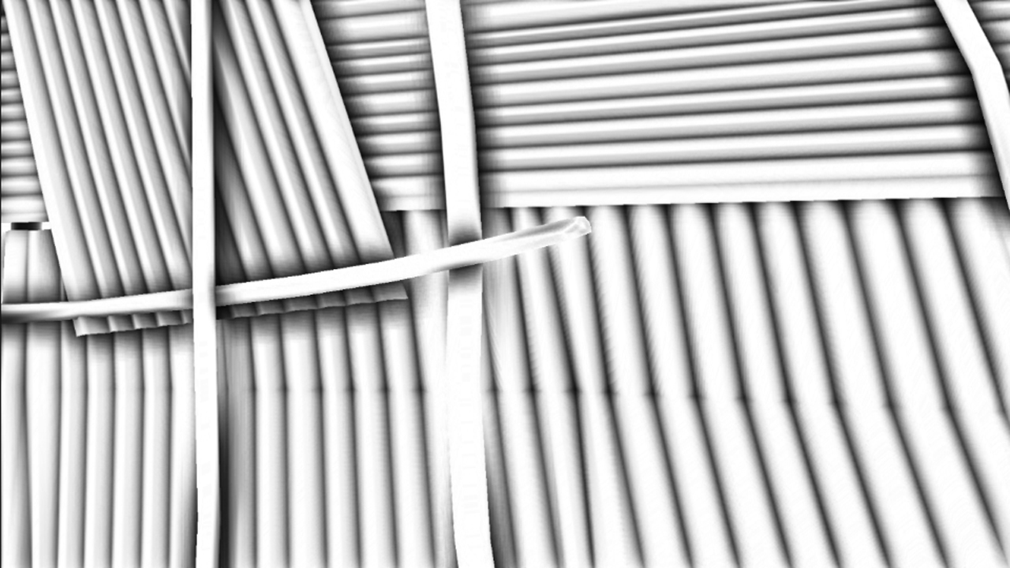
Use Case : SSAO / Bilateral Filter
PICS
Notes:
SSAO uses point to point distance and horizon angle.
Bilateral filter weights by Normal and Depth.
13% performance difference.
Visual differences hide in mutliple samples.

Slide 68

Use Case : SSAO / Bilateral Filter
PICS
Notes:
SSAO uses point to point distance and horizon angle.
Bilateral filter weights by Normal and Depth.
13% performance difference.
Visual differences hide in mutliple samples.

Slide 69
Use Case : SSAO / Bilateral Filter
PICS
Notes:
Slight change in distance based AO due to less precise approximation for short distances.

Slide 70

Be a Creative Code Ninja!
GPU so much closer to CPU
Use your SPU / CPU Ninja Skillz!
Old things might surprise you
Trade ALU for BW
Tip of the iceberg
  Scheduling
  Async compute
  Latency Hiding
  Caching
  Tons of things we don’t know yet
  Fun ahead!
Notes:
Cause presentations with LOLcats get more clicks!

Slide 71
Q&A
More Tips & Tricks :
MICHALDROBOT.COM
Catch me on TWITTER
@MichalDrobot
Shoot me email
HELLO@DROBOT.ORG
Notes:
Will add source for finding best K!
Will add Shader Fast Math lib (xcompile / PC / HLSL)!
Soon!

Slide 72
References
GCN
  „Low-level Shader Optimization for Next-Gen and DX11” – Emil Persson
  „The AMD GCN Architecture: A Crash Course" - Layla Mah
  „GCN – Two ways of latency hiding and wave occupancy” – Bart Wronski
  „Compute Shader Optimizations for AMD GPUs: Parallel Reduction” – Wolfgang Engel
  GCN Performance Tweets
Inverse Sqrt
  „Fast inverse Square Root” - Chris Lomont
  "The Mathematics Behind the Fast Inverse Square Root Function Code” – Charles McEniry
  Quake 3 Source Code - github.com/id-Software/Quake-III-Arena
Notes:
humus.name - Emil Persson
laylamah.com – Layla Mah
bartwronski.com – Bart Wronski
http://amd-dev.wpengine.netdna-cdn.com/wordpress/media/2013/05/GCNPerformanceTweets.pdf

Slide 73
Thanks!
Ubisoft 3D Team(s)
Especially:
  Bart Wronski
  Jeremy Moore
  Steve McAuley
  Stephen Hill
AMD Developer Relation Team
Especially:
  Layla Mah
  Chris Brennan

Slide 74

Bonus Slides
?

Slide 75
IEEE Performance Mode
Disable IEEE compliance (-fastmath) to enable VOP3
  Also called IEEE strict
  Compiler will NOT handle
    Denormals
    QNaNs
    Div 0
    Other unsafe cases
  Will use approximate Transcendental Functions
    Without cleanup or accuracy OPs
    Precision varies but guaranteed to be ~1 ULP (IEEE requires 0.5 ULP)

Slide 76
IEEE Strict vs Non-Strict : X / Y
float r = inV.x / inV.y;
// Without IEEE strict
// x – v1 y – v2
v_rcp_f32 v0, v1 // Unsafe rcp()might produce NaN
v_mul_f32 v0, v2, v0
// IEEE strict safe –fastmath
// x – v1 y – v2
v_rcp_f32 v0, v1 // Unsafe rcp()might produce NaN
v_mov_b32 v1, #0x7f7fffff // MAX_FLT
s_mov_b32 s1, #0xff7fffff // MIN_FLT
v_med3_f32 v0, v0, s1, v1 // safe clamping to clean NaNs
v_mul_legacy_f32 v0, v2, v0

Slide 77
IEEE Strict vs Non-Strict : X / Y
float r = inV.x / inV.y;
// IEEE strict safe accurate flush denormals
// x – v1 y – v2
v_rcp_f32 v0, v1
v_mul_f32 v0, v0, v2
v_div_fixup_f32 v3, v0, v1, v2 // Fix -/+ INF NaN QNaN

Slide 78
IEEE Strict vs Non-Strict : X / Y
float r = inV.x / inV.y;
// IEEE strict safe accurate support denormals
// depending on rounding modes and denormal output
// compiler can add:
v_rcp_f32
v_mul_f32
v_div_scale_f32
nop
nop
nop
nop
v_div_fmas_f32

